Slide 1
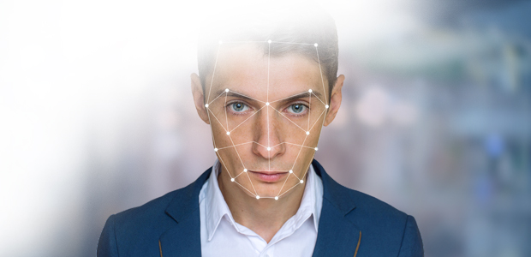
Automated Attendance System – By A.i.
In a Contribution with –
Aayush Shah
Dakshesh Shah
Jay Thakkar

Slide 2


Why to Automate ?
To make the attendance faster without
human intervention.
No need to mark a presence of an employee
by himself and there is no need to dedicate a
person to take attendance.

Slide 3



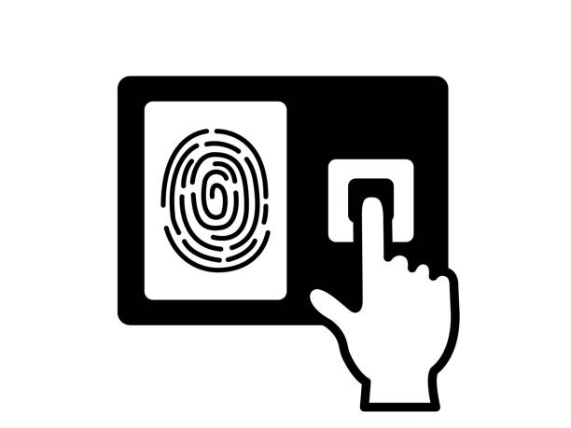

Some Good Solutions
1. Scanning ID cards
2. Using Scanners
3. Using Face Recognition

Slide 4

Where…
Scanning ID Card with RFID Scanner becomes :
Costly
Maintenance (Need to provide individual cards with built in chip )
Fingerprint Scanner is :
Costlier Than anything ( With the System Installed )

Slide 5







But With Face Recognition...
It is Affordable
One-Time Small Investment (OTSI )
Easy to use ( Just Show your face ! )

Slide 6
How it generally works ?
Step 1
Create faces’ dataset and train ( One time train only )
Step 2
Detect the face and pass in the Neural Network
To recognize the person
Step 3
If the person is recognized, then mark his/her presence
In the database ( Attendance )

Slide 7

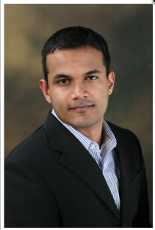

In Our System…
Simple Right ?
CNN ( FaceNet )
DNN ( For Classification )
Training Phase
Testing Phase
Get Details & Mark Attendance
Images
Database
ID, Name and Details…

Slide 8

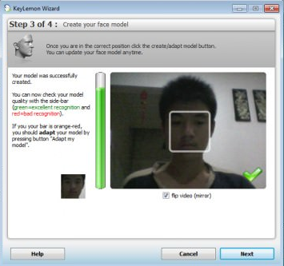
Technologies Used
Python ( Tkinter library for GUI )
Python, ML Libraries i.e. Keras, MySQL

Slide 9







Project’s Abilities and In-Abilities
( Scope )
Features ( It CAN do ) :
Add A new Employee [ With Details ]
Restrict A Employee
Recognize the Face and mark an attendance
Store the Unknown faces
Hold the entry on person’s leave [ For given time ]
Generates the monthly report
Unknown

Slide 10






Project’s Abilities and In-Abilities
.
( Scope )
Features ( It SHOULD do ) :
Manage Overtime
Export data to Payroll System
Features ( It COULD do ) :
Edit The Employee Data
Login of an Adminstrator
.

Slide 11


Project’s Abilities and In-Abilities
( Scope )
Features ( It CAN’T do ) :
Manage In & Out of every person
Mobile SMS based on clock-in/out on leave request
Employee profile, shift management

Slide 12




Some - Limitations
False Attendance
Lack of Accuracy
As being a computerized system, our system can recognize persons’ faces with 92% accuracy
The person has to keep his face all time for attendance !

Slide 13





Good Things!
Cheap ( Affordable under Rs. 1000 )
For Good results the party can buy costly camera for better accuracy and better results
Only a simple working Computer !
The party can enjoy the perks of having such an automated system !

Slide 14
Stack Holder(s)
Companies
Offices
Schools & Colleges ( For Staff )

Slide 15
References
www.shutterstock.com -- Images
www.vectorstock.com -- Symbols
https://github.com/satinder147/Attendance-using-Face -- Implementation Ideas
www.stackoverflow.com -- Confusion Solution

Slide 16
THANKS !

